Slide 1
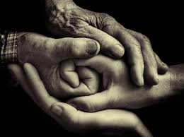
‘Personal neurobiology’: What’s in it for us?
Celia Roberts
June 2017
Notes:
Conference – May 2017
‘Attachment and trauma: The resilience of mind and body’ London
Key speakers: Louis Cozolino, Rachel Yehuda, Bessel van der Kolk, Diana Fosha, Antonio Damasio, Stephen Porges, Vittorio Gallese, Daniel Siegel (and leading trauma therapists, including Judith Herman).
https://www.google.com/search?site=&tbm=isch&source=hp&biw=978&bih=526&q=polyvagal+theory&oq=poly+vagal+&gs_l=img.3.0.0i10i24k1l2.3122.5292.0.6507.13.13.0.0.0.0.572.1574.3j5j5-1.9.0....0...1.1.64.img..4.9.1570.0..0j0i10k1.788iKvH318A#imgdii=kUG1OJ4QAXG6GM:&imgrc=5gNbBzNAGZWW0M:

Slide 2
Old dichotomies
nature/nurture
biology/culture
body/mind
genes/environment
health/illness
child/adult
human/animal
self/other
same/different
All problematised in this field, either explicitly or implicitly.
Notes:
Strong engagement with philosophy and history of science: Canguilhem, James, Darwin etc. (but no deleuze, grosz or wilson to date!)

Slide 3
Embrained body
The brain is of and in the body (head brain, heart brain, gut brain); we are ‘embrained’ (Porges, Gallese).
Bodies are ‘served’ by brains and nervous systems – all elements of the brain are interactive (Damasio)
The mind is an emergent system – more than the body, moving beyond the skin in and through relations (Siegel)
Notes:
Mind/body
Biology/culture

Slide 4
Social nature
Biology is social – e.g. Porges’ ‘polyvagal theory’ and ‘neuroception’
Connnectedness is physiologically necessary – humans (and other mammals) require care
‘Nurture is our nature’ (van der Kolk)
Quest for safety and to regulate ourselves both require others.
Need to talk about patterns not inherent features
Notes:
Licking by mothers changes your biology – epigenetic changes
Attachment system trumps the trauma one – hence children can survive poverty/ trauma etc if in secure attachment relationships [army uses this]
Abused/ neglected children: affect dysregulation, concentration, self loathing, loathing of others, aggression
Poor health outcomes
Epigenetic changes to cell methylation. Low cortisol. etc

Slide 5
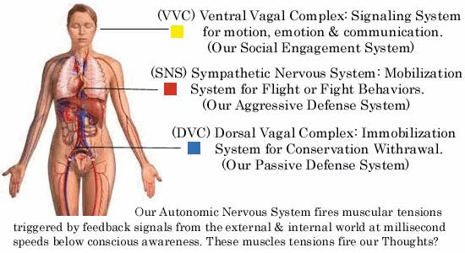
Polyvagal theory (Porges)
Notes:
https://www.sott.net/article/228410-How-your-nervous-system-sabotages-your-ability-to-relate

Slide 6
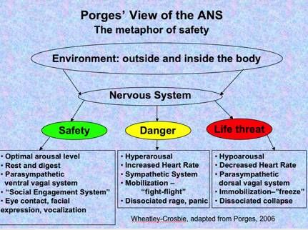
Neuroception

Slide 7
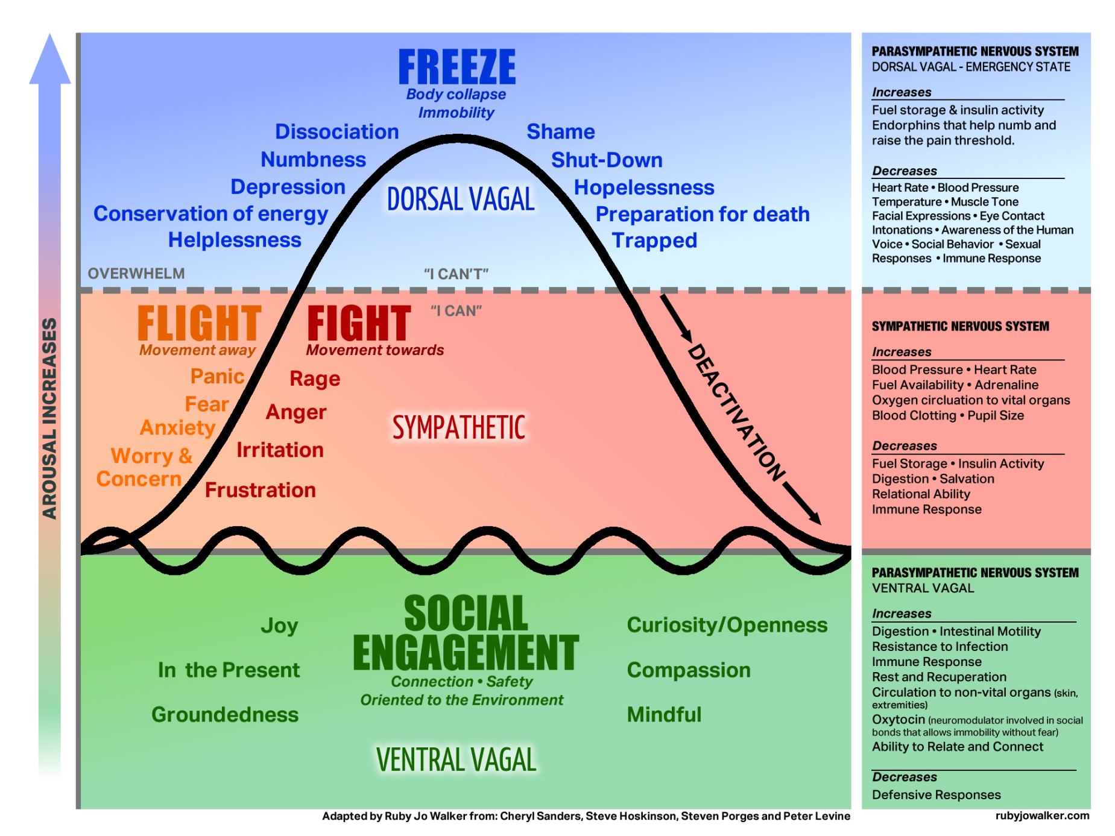
Notes:
https://www.google.co.uk/search?q=polyvagal+evolution&client=firefox-b-ab&source=lnms&tbm=isch&sa=X&ved=0ahUKEwi6oLvTjLjUAhVpLMAKHW-1CkEQ_AUICigB&biw=1092&bih=587#tbm=isch&q=polyvagal+evolution+brain&imgrc=B7-I4dfltZPsKM:
https://paradigmmalibu.com/teen-somatic-experiencing/

Slide 8
The ‘long line of life’
Humans are part of a long evolutionary line, and share characteristics with bacteria, reptiles, mammals
Need to think about complexity of social mammals but also recognise that we are reptilian in some ways
Commonalities in biology but also deeply etched differences arising from experience
Notes:
Insert slide from Porges about evolution?

Slide 9
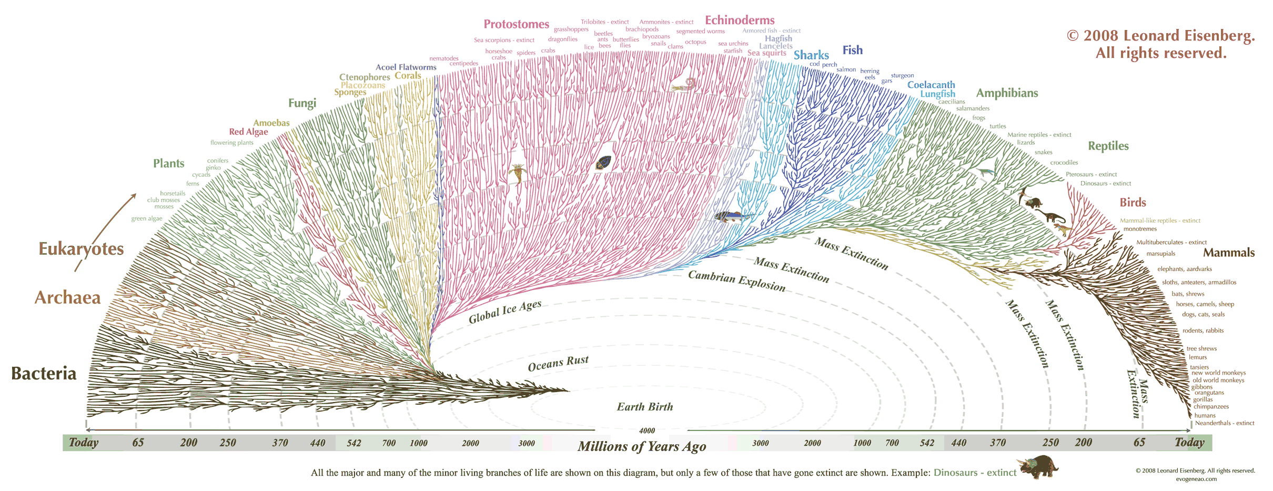
The long lines of life
Notes:
https://www.quora.com/What-is-the-most-complete-visual-human-evolution-chart-available

Slide 10
Health, fitness, flourishing
Organisms are oriented towards more than survival; to flourishing
The passing on of particular ways of being is a reaction to circumstances (epigenetics)
Fitness does not mean strength but fit to a situation (maybe the gentlest will survive)
Notes:
Breaks gene/environment distinction. Genes don’t do anything – they are part of complex systems. DNA doesn’t change, regulation of gene action does.

Slide 11
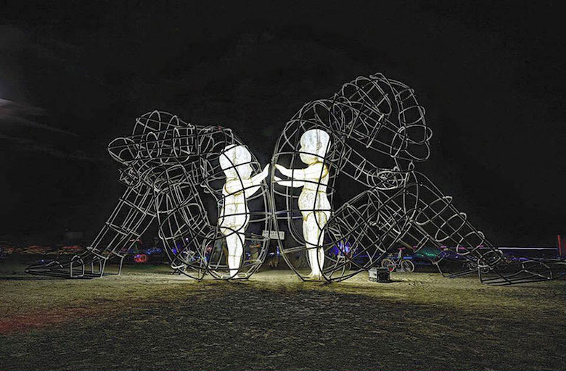
Childhood
We do not leave childhood behind – adults have their childhood in their minds/ embrained bodies/ relationships
Much of this is beyond direct conscious knowledge or control (but it can be worked on)
Notes:
https://digitalsynopsis.com/design/love-inner-child-burning-man-sculpture/

Slide 12

Additional key ideas
The self is a plural verb, not a singular noun (Mwe - Siegel)
Humans desire socio/cultural homeostasis or ‘sociostasis’ but with excess (flourishing).
There is huge potential for change: neuroplasticity can be ‘entrained’
(Siegel calls this ‘mindsight’)
Notes:
https://www.explorediscoveract.com.au/single-post/2016/06/13/MWe-Time
‘The human mind is a relational and embodied process that regulates the flow of energy and information.” – Dr. Dan Siegel
https://www.youtube.com/watch?v=B7kBgaZLHaA

Slide 13
What direct questions arise?
What happens in violent encounters and caring encounters?
Why do people respond as they do in violent situations?
How does trauma stay in the body/ relations?
How is change possible at individual and group levels?
How can we help those who have experienced trauma and those trying to care for them?

Slide 14
Wider conceptual issues
Nature of the self/ the mind/ the body
Theories of relationality
Responsibility and responsibilisation (ethics)

Slide 15
Research areas
How are these theories made? What is the nature of the research and clinical work on which they are based?
What forms of visual representation, metaphor, figuration… operate here?
How and where are these ideas taken up, or not? (problems of poor use in public policy and related practice)
How can social scientists/ cultural theorists establish conversations with those in this field?

